Slide 1
Developing 21st Century World Language Skills
Craig Bebergal
Casey Henry

Slide 2
21st Century Skills
Teaming
And
Collaboration
Visual and
Information
Literacy
Managing
Complexity
And
Self-direction
Effective Use
Of Real-World
Tools
Adaptability
Curiosity,
Creativity,
Risk-taking
Interactive
Communication

Slide 3
The “T” Word

Slide 4
Your Students are using Google Translate
despite your objections. So what is it and how
can you turn it into a teaching tool?
As a single item dictionary, it works fairly well
and is much faster than turning pages on a paper dictionary.
It doesn’t work as well as Whitaker’s words though.

Slide 5
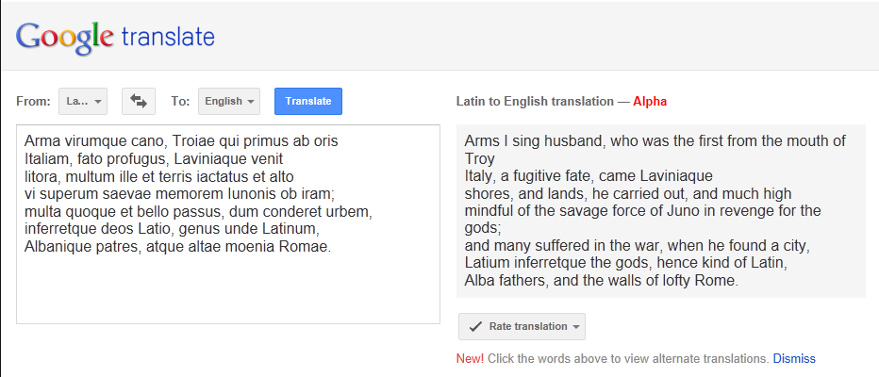
When it comes to passages of large size, it begins to break down.
It also couldn’t find all of the words, such as inferretque and it often choose the least logical definitions, such as husband.
Finally, it lacks knowledge of English syntax.
If the kids copy and paste, you will likely know or they’ll just fail because this wouldn’t earn any points on an AP test.

Slide 6
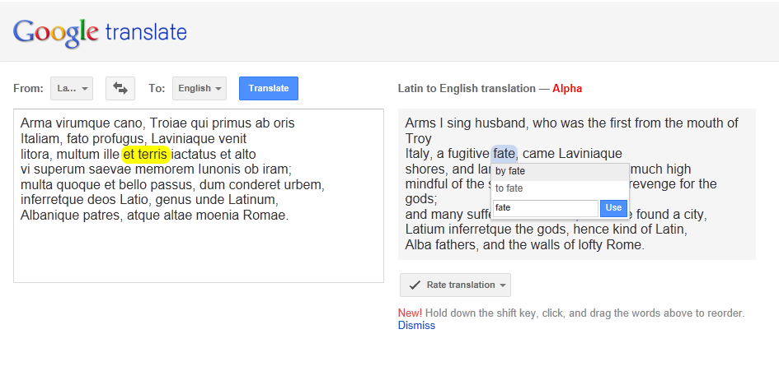
It can be made to work as an adaptive tool though. If you click on an English word, it presents other options and knows that it might be ‘by fate’ or ‘to fate’. I can also reorder the words and to some small extent “teach” google translate.
Ultimately though. It would take the kid less time to just do it themselves.

Slide 7
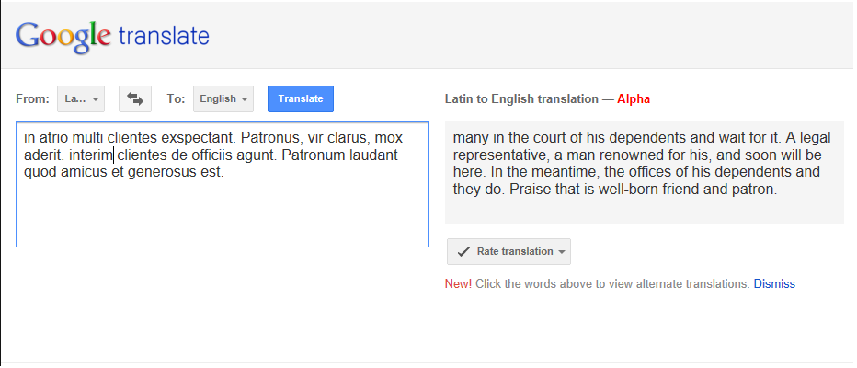
This passage comes from one of the early stories in LFA book 1. It seems that even fairly simple Latin breaks the system. But what if the goal isn’t a translation. How can we use this to teach kids about language.
Could we use this to help break them of the ‘pick the first word in the dictionary even if it doesn’t make sense’ problem?

Slide 8
Here, I took an article from the Nuevo Herald to see how it did with Spanish. The system works much better. So how do we use this as a classroom tool?

Slide 9
Good News. English to Latin is extremely funny!

Slide 10
Social Networking with Google+

Slide 11
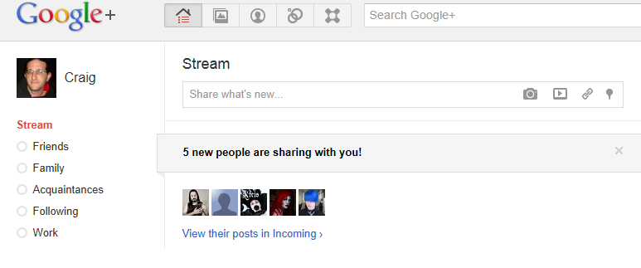

Slide 12
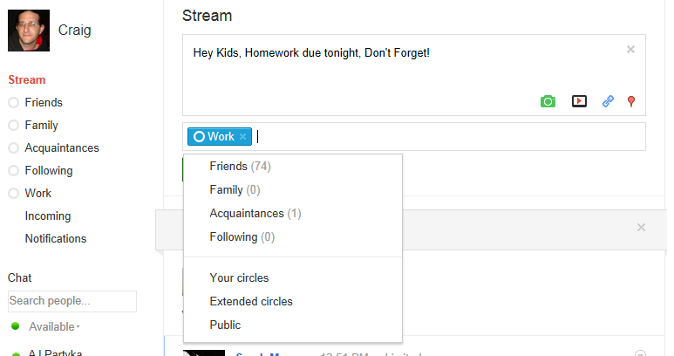
With Google Plus, You have circles. Facebook is working on this same notion.
When I post something, I choose which circles get to see it and which don’t.
This means that I can make a circle called students and another one called friends. My friends won’t get Latin updates and my students won’t see posts about where I go after hours. It also means my mother won’t see posts about where I go after hours ☺

Slide 13
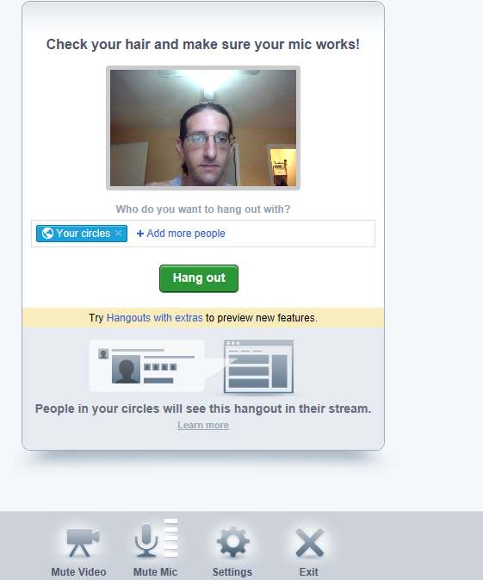
Google+ has a hangout feature which allows for group video or text chat.
Why would you want to do this
Kids could do oral assignments at home this way and you wouldn’t lose class time having them come up 1 by 1.
Remember that kid with mono? Want to tutor the kid with mono?
Great way to do it.
Want your students to be able to work cooperatively on projects without their parents having to drive them around?

Slide 14
Discussion
How many of you use social networking with your students?
How do you use it?
Limitations? Benefits? Liabilities?

Slide 15
Collaboration

Slide 16
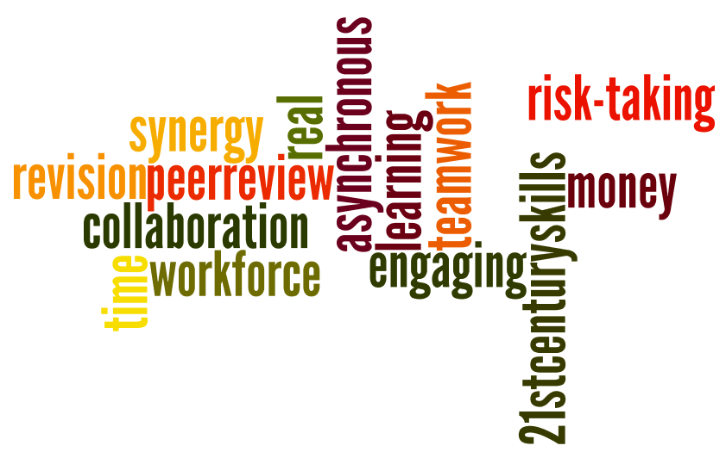
What’s the Big Deal?

Slide 17
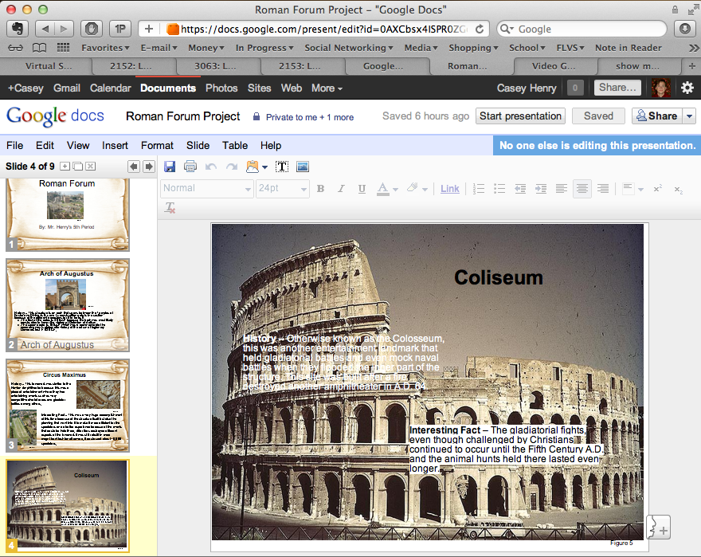
Student Presentation

Slide 18
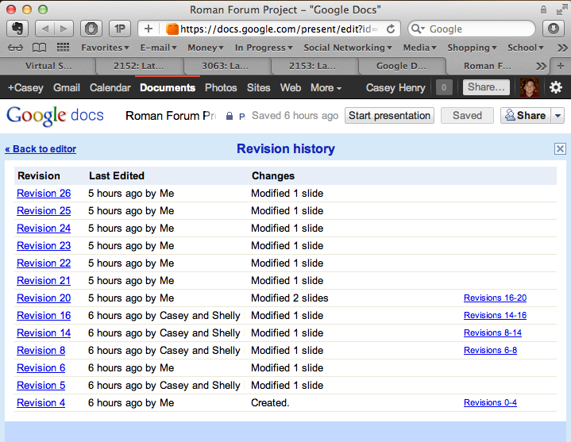
Student Presentation – Revision History

Slide 19
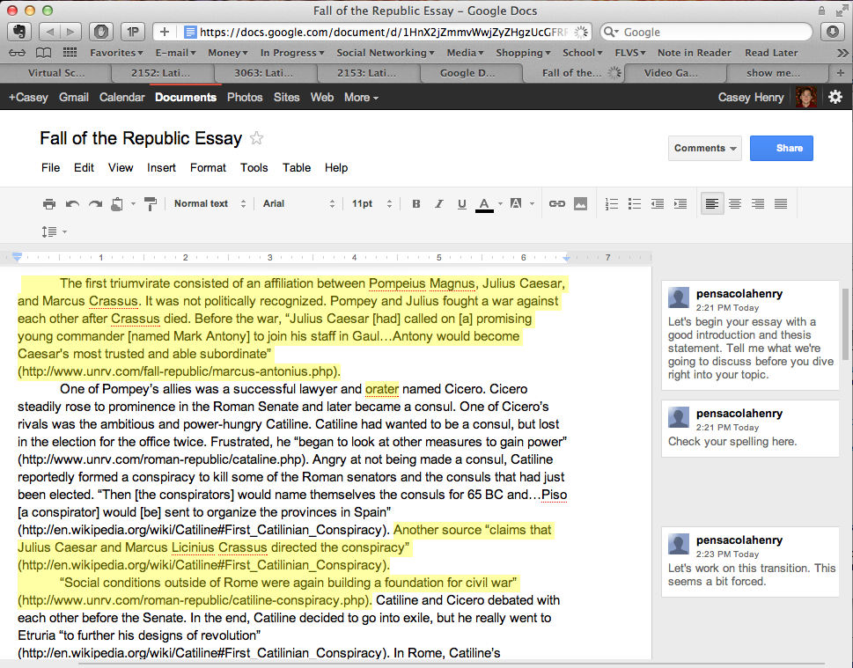
Student Peer Revision

Slide 20
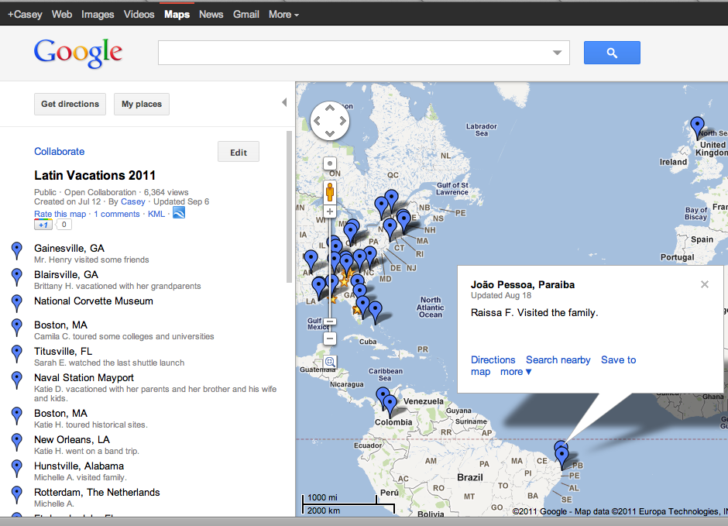
Student Fun – Vacation Map

Slide 21
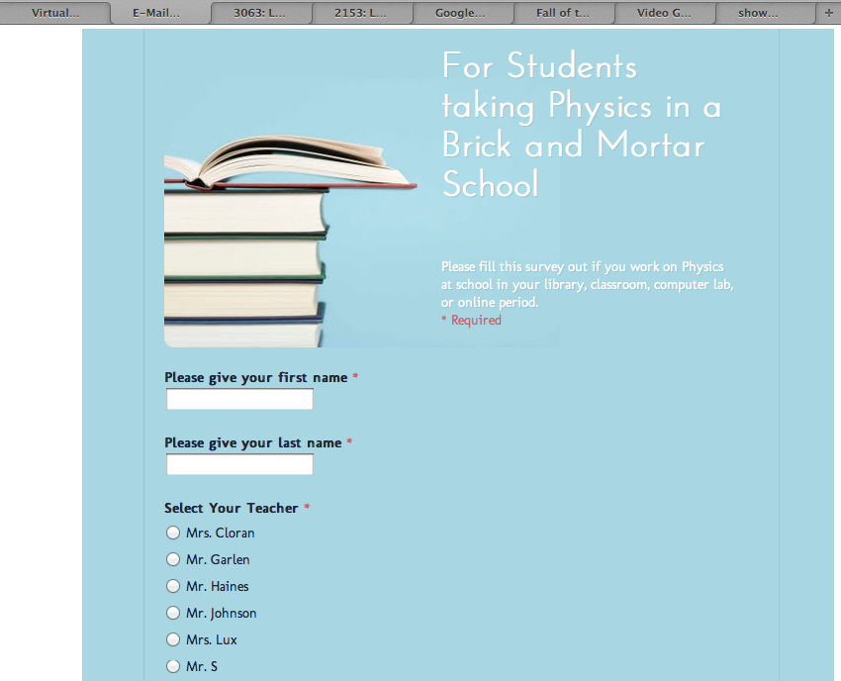
Student Feedback

Slide 22
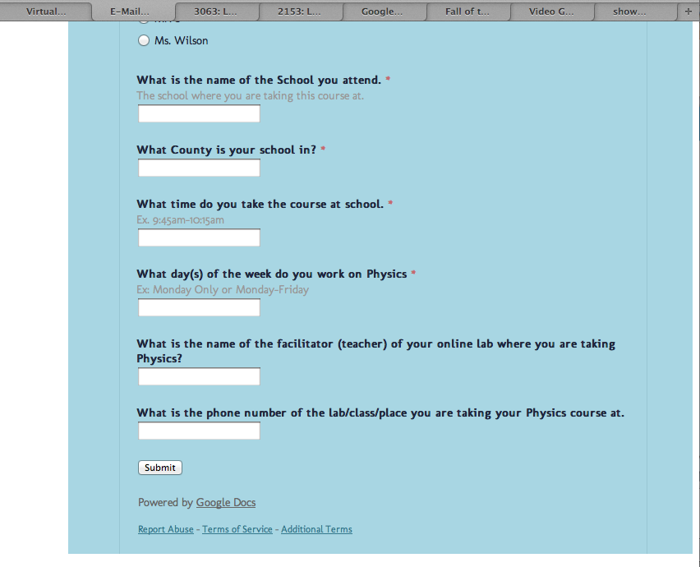
Student Feedback, continued

Slide 23
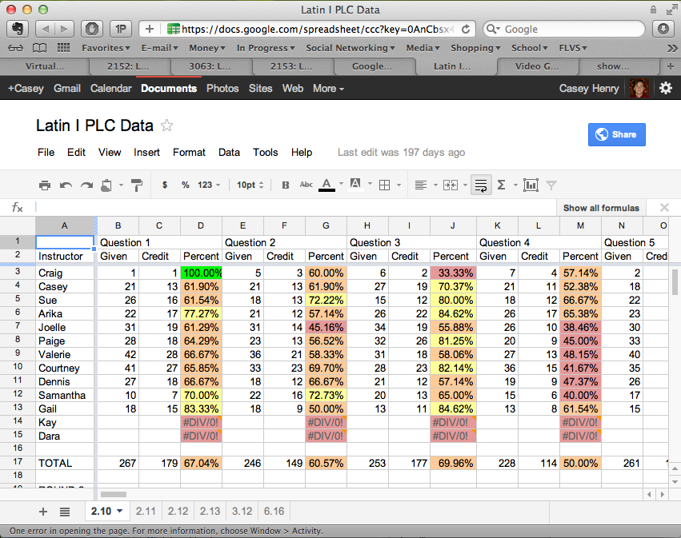
Teacher Collaboration – Assessment Data

Slide 24
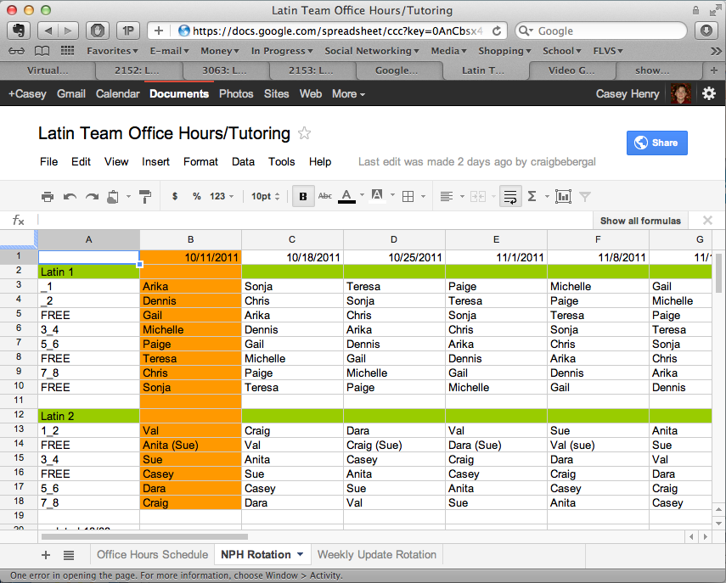
Teacher Collaboration - Scheduling

Slide 25
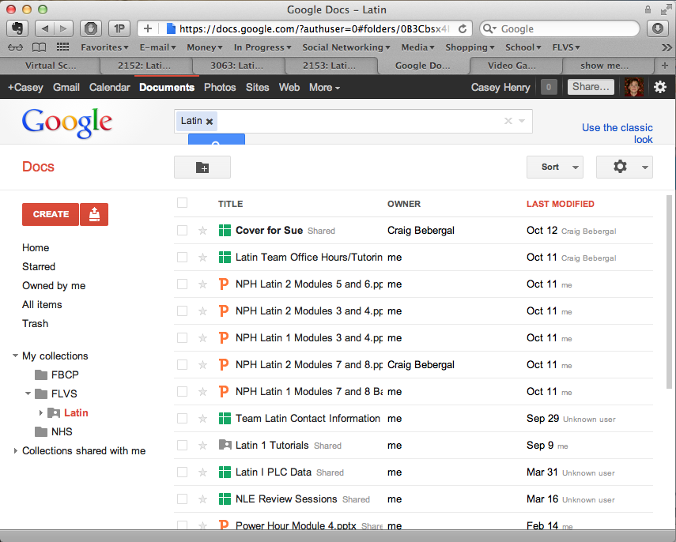
Document Sharing

Slide 26
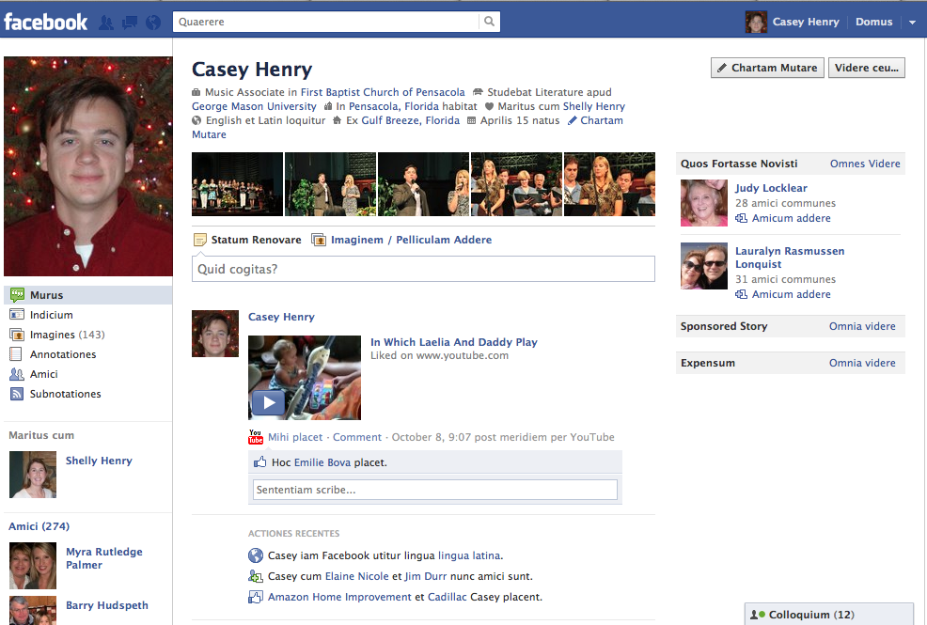
Student Fun – Facebook…in Latin!

Slide 27
Possibilities

Slide 28
Where do we go from here?

